Slide 1

Evaluation of Various Machine Learning Approaches to Predict PM2.5 Concentrations
Presented by: Preetham Pangaluru
Mentor: Dr. Jonathan Jiang

Slide 2
How Data Was Obtained
PM2.5 Data Set:
Using API to access data from OpenAQ with a
base url of "https://api.openaq.org/v1/measurements"
The PM2.5 Data set was from Jan 01, 2018 – Dec 31, 2021 and was
made into daily, monthly, and seasonal average data as well to better predict trends in each of those temporal periods

Slide 3
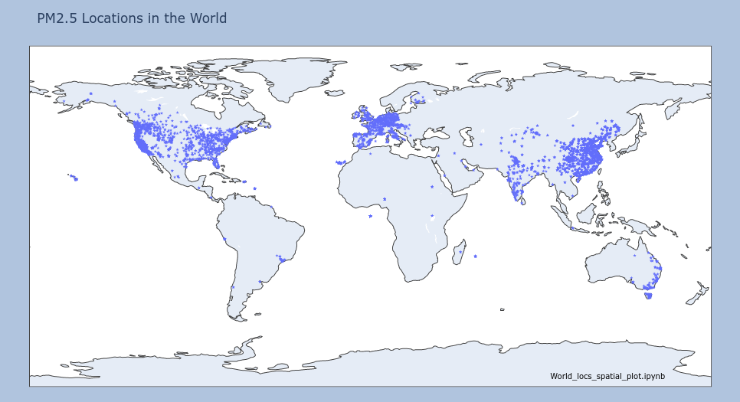
Fig. 1: PM2.5 locations (stations) around the world

Slide 4
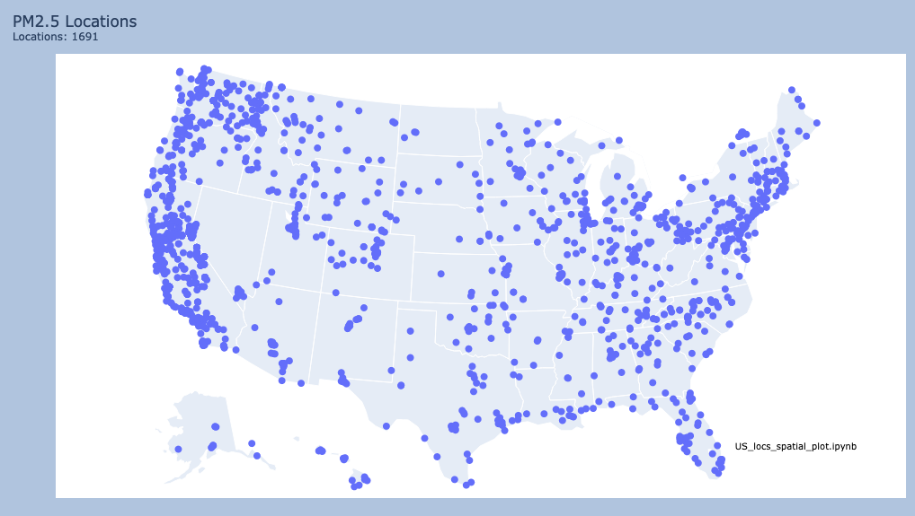
PM2.5 Locations Around the United States
Fig. 2: There are 1691 PM2.5 locations around the US

Slide 5
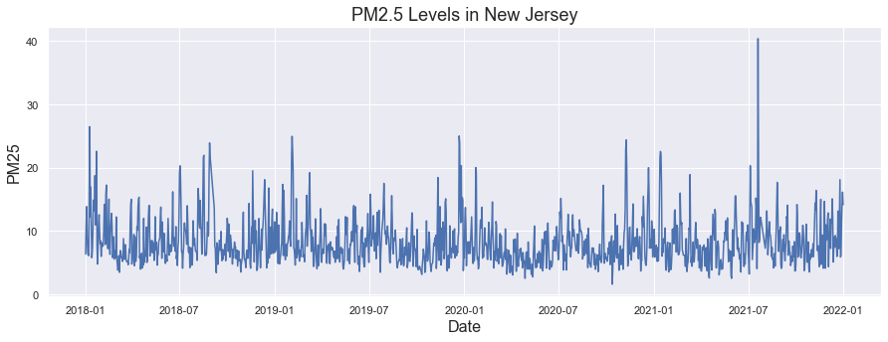
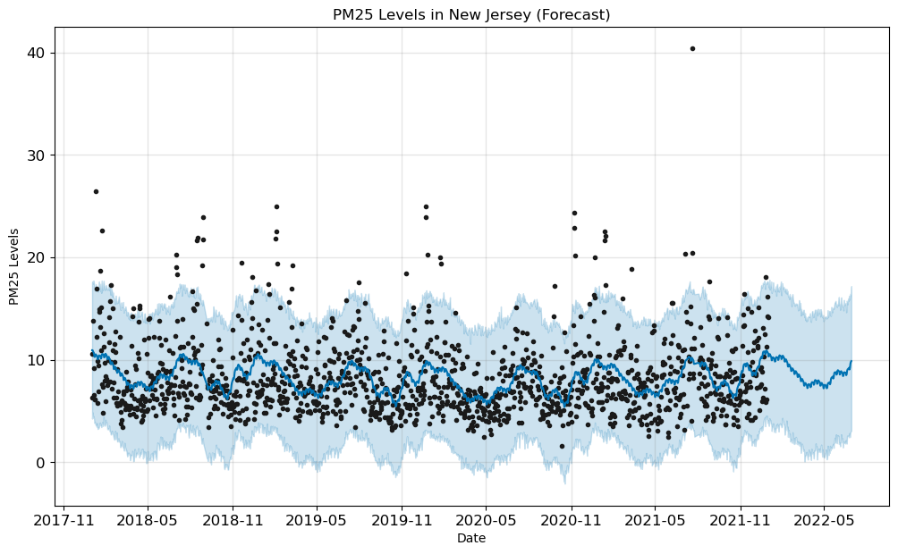
Fig.3: Daily PM2.5 time series (top) and bottom forecast predictions.

Slide 6
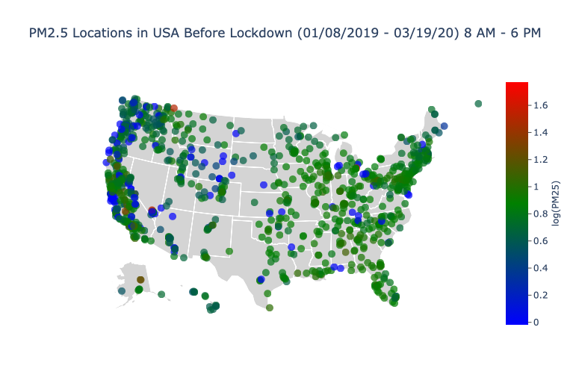
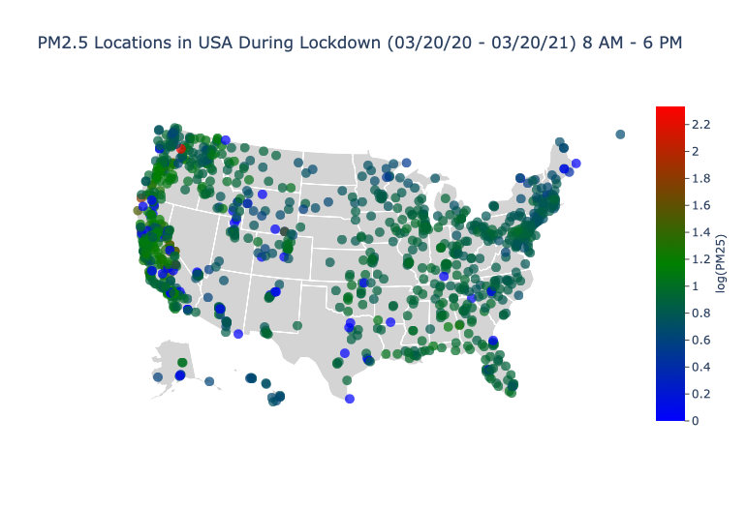
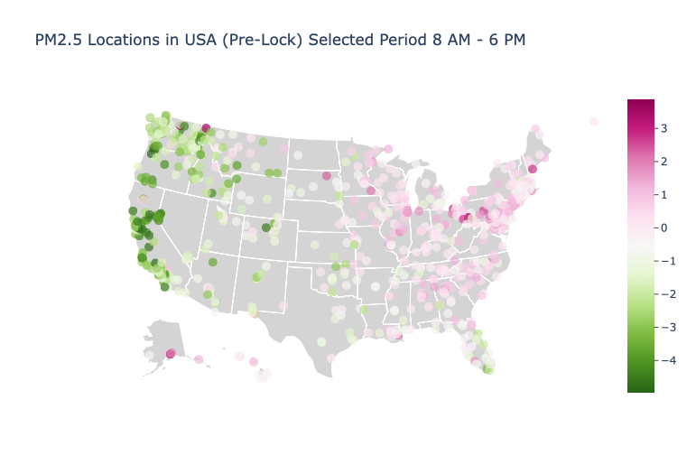
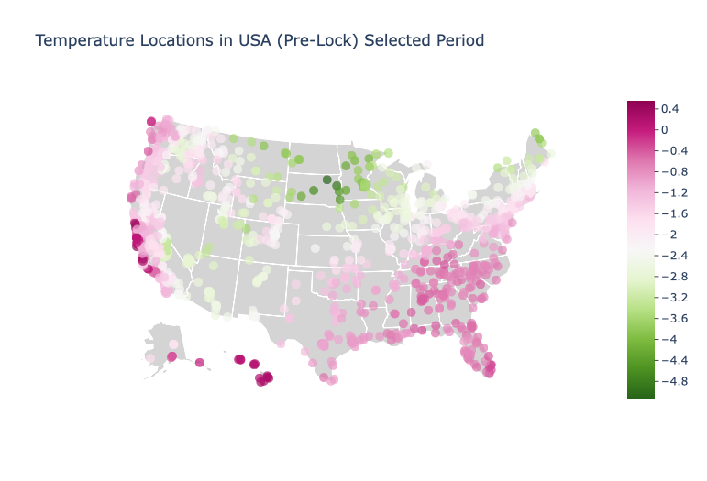
Before and During Lockdown: A Visual Comparison of PM2.5

Slide 7
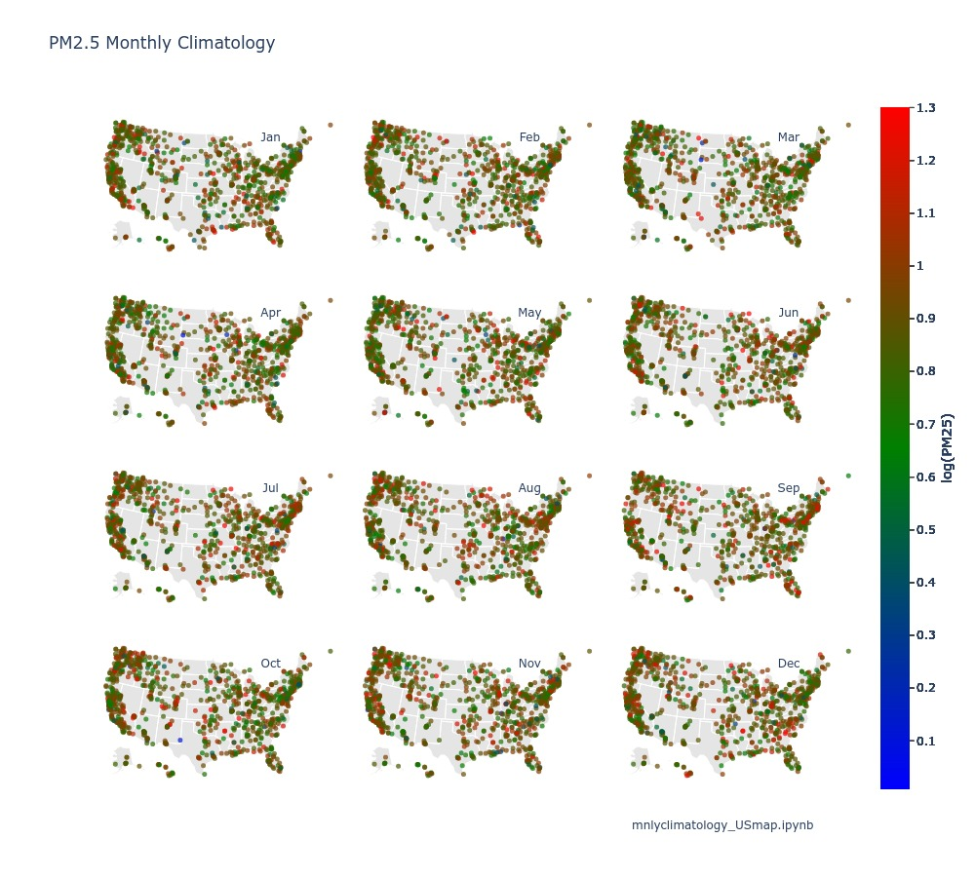
Fig. PM2.5 monthly climatology over each location during Jan 2018 – Dec 2021.

Slide 8
Fig.: Monthly PM2.5 anomalies for different years (2018 – 2021)

Slide 9
Fig.: USA monthly anomalies during the period from 2018 to 2021.

Slide 10
Fig.: California PM2.5 daily time series (blue) and predictions (red) for different ML models

Slide 11
Fig.: PM2.5 observed and predicted scatter plot for different ML models

Slide 12
Table Demonstrating Error Metric Comparison of ML Models
California
Model | RMSE | MAE | MSE | R2 | NSE | NORM | PBIAS
Linear Regression | 3.883 | 2.309 | 15.077 | 0.688 | 0.70 | 60.156 | 4.24
Decision Tree | 5.136 | 3.109 | 26.387 | 0.454 | 0.533 | 79.58 | 3.44
Gradient Boost Regressor | 3.822 | 2.394 | 14.606 | 0.698 | 0.683 | 59.207 | 5.21
AdaBoost Regressor | 3.961 | 2.316 | 15.693 | 0.676 | 0.683 | 61.369 | 4.653
XG Boost | 3.898 | 2.501 | 15.197 | 0.686 | 0.681 | 60.393 | 4.342
KNeighbors Regressor | 3.919 | 2.379 | 15.358 | 0.683 | 0.677 | 60.711 | 4.515
LSTM | 7.487 | 3.359 | 56.058 | 0.158 | 0.255 | 115.991 | 6.00
Random Forest | 3.121 | 2.122 | 11.348 | 0.899 | 0.211 | 38.671 | 2.989
SVM | 3.125 | 2.145 | 12.129 | 0.857 | 0.280 | 39.161 | 3.011

Slide 13
Conclusion
Machine Learning models are relevant to the study of PM2.5 concentrations across the USA
and other parts of the world
Our variety of developed ML models provide a robust and accurate measure of PM2.5 levels
In USA and can even possibly be extended to other forms of particulate matter and pollution
New ML models and techniques have allowed us to further predictive ability when it comes to
PM2.5 levels
The SVM, RF, and LSTM models were the best at capturing temporal dependencies in time series data,
Increasing accuracy of PM2.5 forecasting
Fall and winter were especially harder to predict because they happened to have higher levels of
air pollution and especially, PM2.5 concentrations

Slide 14

Thanks For Watching

